Slide 1



Scoriant Technology
| 07/04/2026
AI SOLUTIONS
PORTFOLIO
Technical Architecture, Workflows & Benchmark Report
PRESENTED BY:
PRESENTED TO:
Anand Gopalkrishna
Ministry of Home Affairs

Slide 2


Contents
01 | Document Intelligence Chatbot
02 | AI Knowledge Studio
03 | Face Recognition & Attendence
04 | Change Detection
05 | Object Detection
06 | Video Analytics and OCR

Slide 3

Overview
AI powered solutions providing intelligence, security & operational efficiency for MHA
20+
200+
AI Models Integrated
Languages supported
100%
<3s
Data Privacy with no external API calls
Processing latency

Slide 4

Document Intelligence Chatbot
04/28
Transforming organizational documents into an interactive, multilingual knowledge platform with RBAC and semantic search
# 1
# 2
# 3
Multi Format Ingestion
Multilingual Support
Semantic Search
PDF, DOCX, PPT, Excel, TXT,
Image-based docs via OCR
Auto language detection + translation to English before indexing. English → Indic Languages
FAISS vector store for contextual retrieval with chunk-level indexing
# 4
# 5
# 6
RBAC & Dept. Access
Grounded Responses
Semantic Search
Role-based access — users retrieve only authorized documents
Answers strictly generated from retrieved evidence with source
citations
FAISS vector store for contextual retrieval with chunk-level indexing

Slide 5
Document Intelligence Chatbot
05/28
Transforming organizational documents into an interactive, multilingual knowledge platform with RBAC and semantic search
# 1
# 2
# 3
Multi Format Ingestion
Multilingual Support
Semantic Search
PDF, DOCX, PPT, Excel, TXT,
Image-based docs via OCR
Auto language detection + translation to English before indexing. English → Indic Languages
FAISS vector store for contextual retrieval with chunk-level indexing
# 4
# 5
# 6
RBAC & Dept. Access
Grounded Responses
Semantic Search
Role-based access — users retrieve only authorized documents
Answers strictly generated from retrieved evidence with source
citations
FAISS vector store for contextual retrieval with chunk-level indexing

Slide 6
System Architecture & Workflow
06/28
End-to-end document processing and retrieval pipeline
# 1
# 2
# 3
Document Upload
Content Extraction
Language Detection
PDF/DOCX/PPT/Excel/Image upload via secure web interface
Page-by-page text extraction; OCR for image-based docs (Tesseract/PaddleOCR/VLM’s)
langdetect identifies non-English; MarianMT/Helsinki-NLP
translates to English
# 4
# 5
# 6
Semantic Chunking
Vector Embedding
Dual Storage
Text split into overlapping semantic chunks (512 tokens) preserving context
Sentence-BERT / all-MiniLM-L6-v2 generates dense embeddings per chunk
FAISS indexes embeddings; MongoDB stores metadata (doc ID, page, dept)
QUERY FLOW
USER
QUERY
RBAC
Auth Check
Embed
Query
FAISS Similarity Search (TOP-K)
LLM Answer generation + Source citiation & TTS

Slide 7
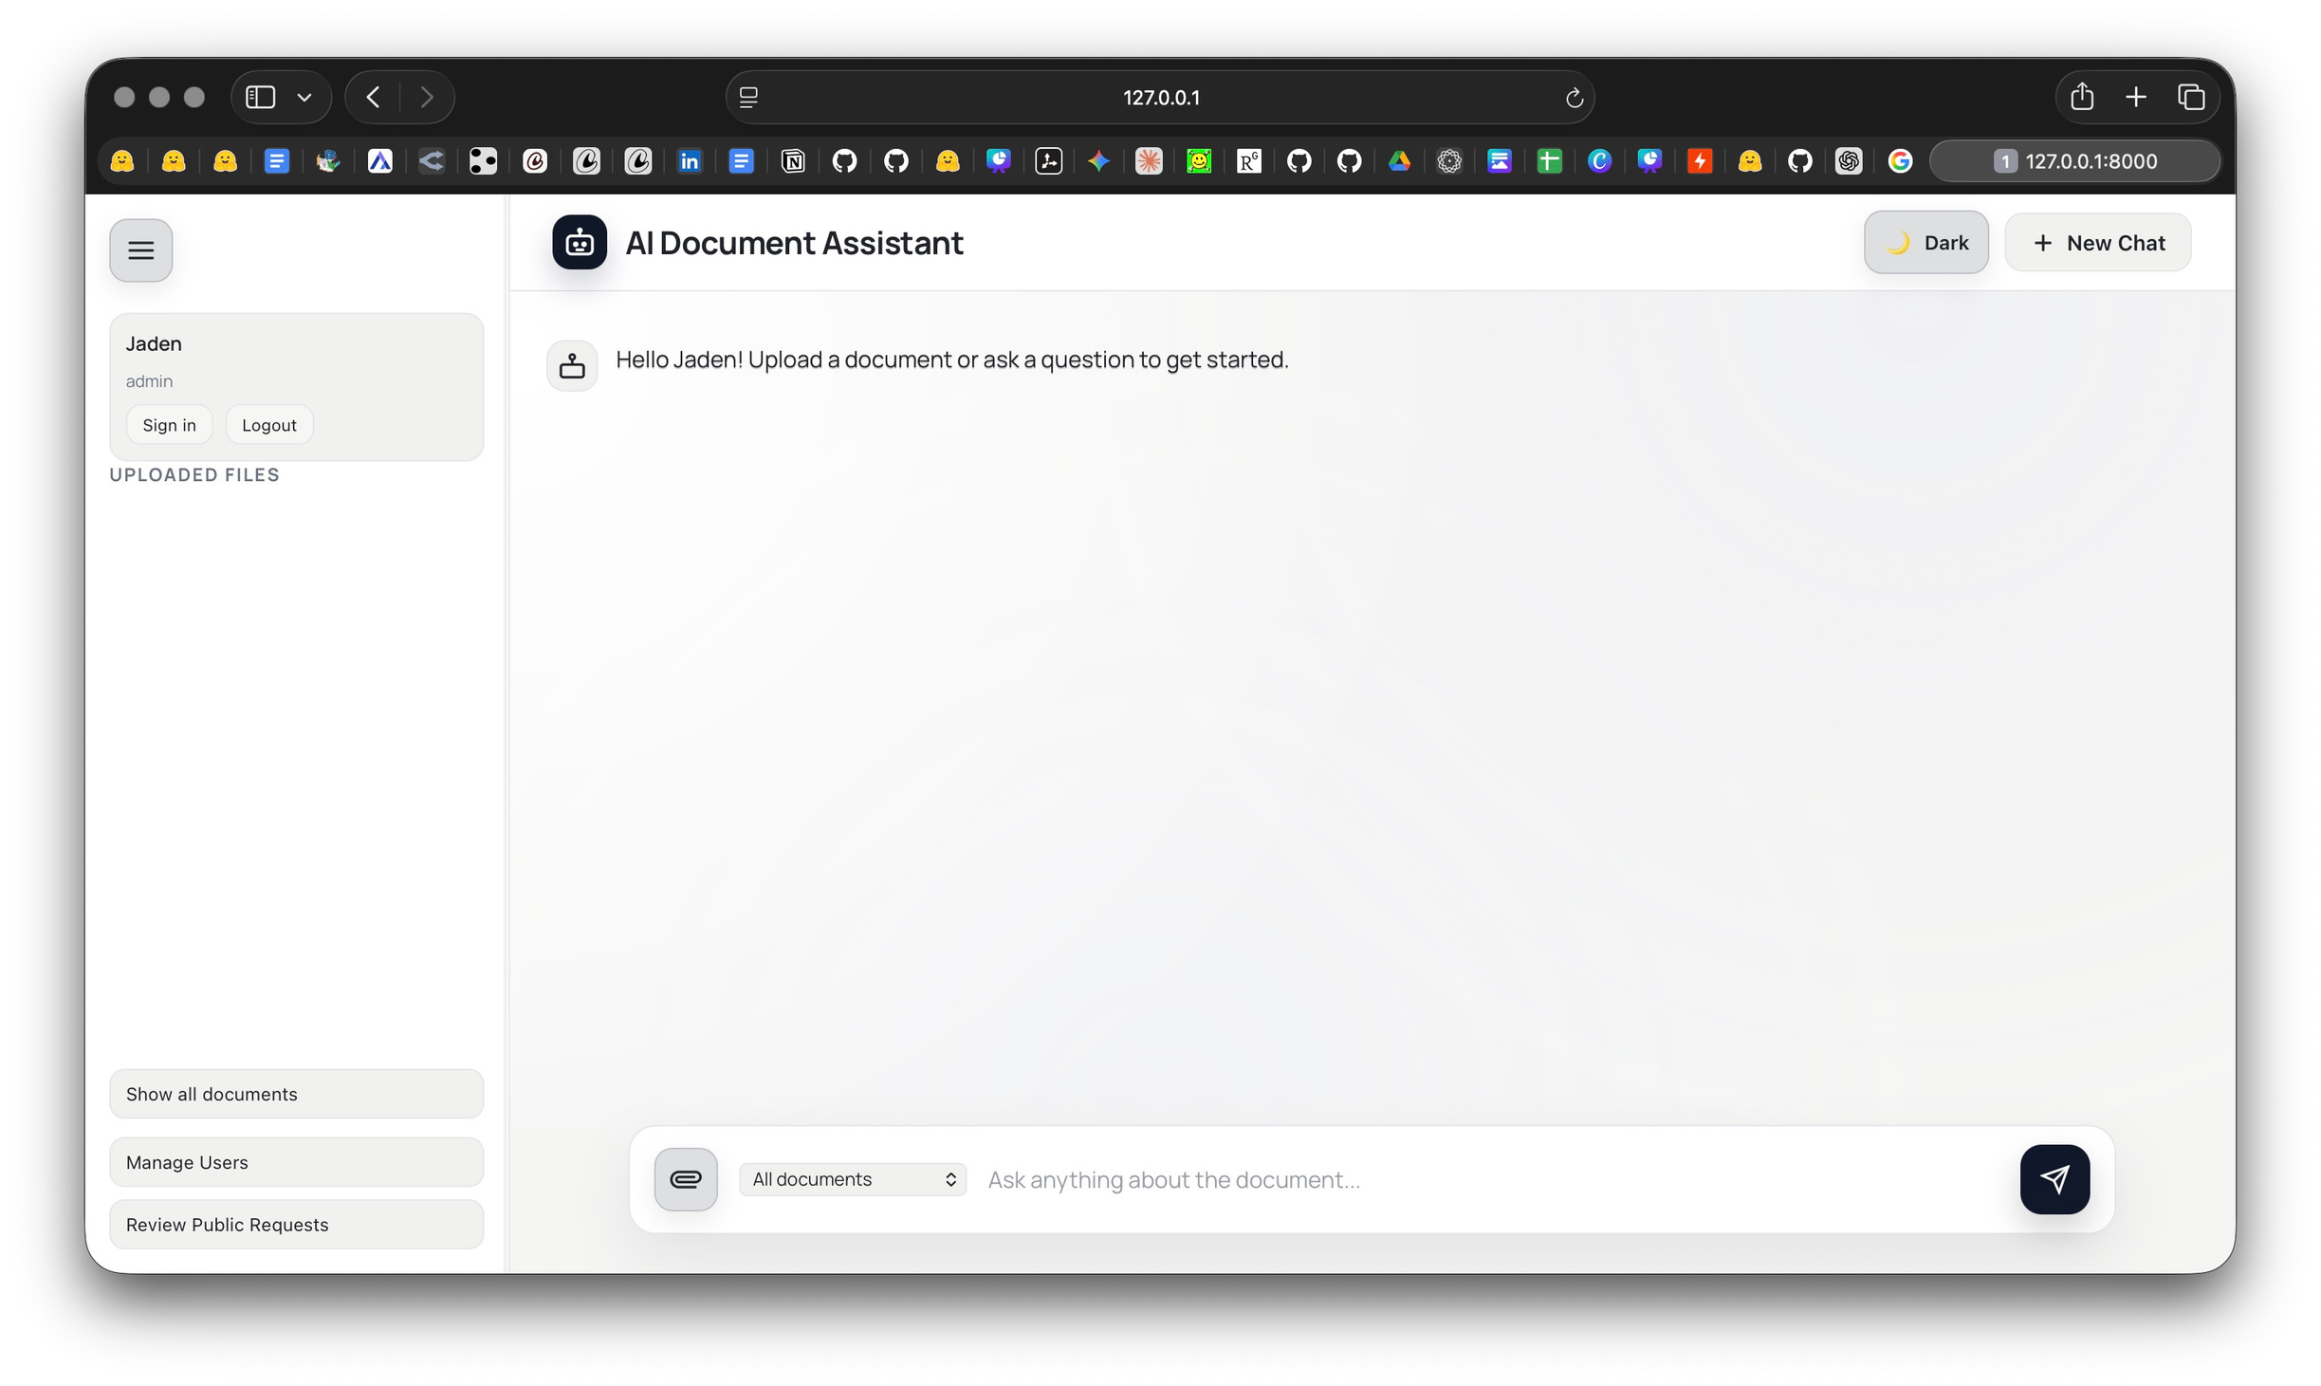
Screenshot
07/28

Slide 8
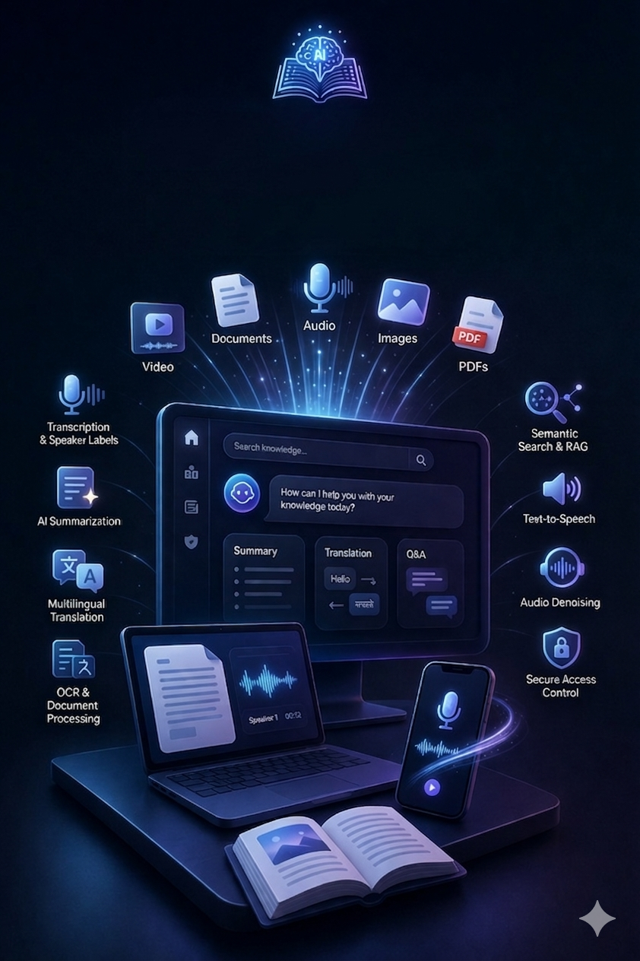
AI Knowledge Studio
08/28
AI Knowledge Studio is an advanced AI-powered platform built to transform scattered enterprise content into a centralized, interactive, and searchable knowledge ecosystem. It supports a wide range of input formats including audio, video, images, PDFs, and documents, enabling organizations to process and understand information from multiple sources in one place. 🚀
The platform enables users to transcribe conversations, summarize long content, translate information into multiple languages, extract text from images and documents, and interact with content through intelligent question-answering. It also enhances audio quality, generates speech from text, and makes information easier to access across teams and departments. 🌍
With advanced search capabilities and secure access controls, users can quickly find the most relevant information while ensuring that content is only accessible to authorized individuals. This creates a smarter, faster, and more efficient way for organizations to manage, share, and use knowledge. 🔍

Slide 9
09/28
AI knowledge Studio
Building an AI knowledge studio that processes documents, audio, video, and images with multilingual translation, summarization, denoising, text-to-speech, RBAC, and contextual search 🌐
# 1
# 2
# 3
Multi Format Ingestion
Agentic Support processing
Tasks and Agents Capailities
Video, Audio, Document, PDF, Image, Real time Audio,and many more
Process the Tasks based on the query of the user by calling the Agents through prompt ( Ex : Video input + Query Prompt)
Video conversion, Audio Conversion, Diarization, Denoise, OCR, Summarization,Multilingual translation, Q&A feature, ChatBot featuring response
# 4
# 5
# 6
RBAC & Dept. Access
Grounded Responses & Exported
AI-Powered Search with Context Awareness
Role-based access — users retrieve only authorized documents and access
Answers strictly generated from retrieved evidence with source
citations and with the Exportable Media
Natural language search and Retrieve Statergy using semantic similarity and vector search

Slide 10

CAPABILITIES | Tools / Models Used | PURPOSE
Video to Audio Conversion | MoviePy | Extracts audio from uploaded video files for further speech processing
Speech Recognition | Faster-Whisper | Converts audio into accurate text transcripts with multilingual support
Speaker Diarization & Mapping | Nvidia NeMo Model | Identifies multiple speakers and maps dialogue segments to each speaker
Content Summarization | Mistral-7B-Instruct / Ollama | Generates concise summaries from transcripts, PDFs, documents, and images
Chatbot & Q&A | Mistral-7B-Instruct | Enables conversational question answering over processed content
Multilingual Translation | NLLB-200 | Translates text into multiple languages with contextual accuracy
Text-to-Speech | gTTS | Converts generated text responses into speech output
Media Processing | FFmpeg | Handles audio extraction, normalization, format conversion, and media optimization
OCR for Images | Tesseract OCR | Extracts text from images, scanned files, and screenshots
PDF & Document Processing | PyPDF | Reads and extracts text content from PDFs and document files
Semantic Search | FAISS / Vector Database | Performs contextual search using embeddings and chunk-level retrieval
RBAC & Secure Access | JWT | Restricts access based on user role, department, and authorization level
Retrieval-Augmented Generation (RAG) | RAG Pipeline with PDF Retrieval | Retrieves relevant document chunks before generating grounded responses
Audio Denoising | Demucs | Removes background noise and improves speech clarity from recordings
Resource
CENTRALIZED PLATFORM TOOLS FOR SMARTER KNOWLEDGE MANAGEMENT AND COLLABORATION. 🔍

Slide 11


System Architecture & Workflow
11/28
Data capture and History
4.Langchain & Agentic Workflow
6.Output processed
The Entire conversation is stored in History and also Stores the meta data
2.Input layer
Query understanding + Tool Deciding Phase
The Output is Processed and also has Q& A Feature.
Media upload + QueryPrompt
1. RBAC & Authentication
3.Input validation
5.Tool calling
7.Post Output Features
Query understanding + Media processing
many tools like :Audio conversion, video Conversion,diarization ...etc
Keyword spotting, Sumarization, Translation, Export, etc.
uses JWT

Slide 12
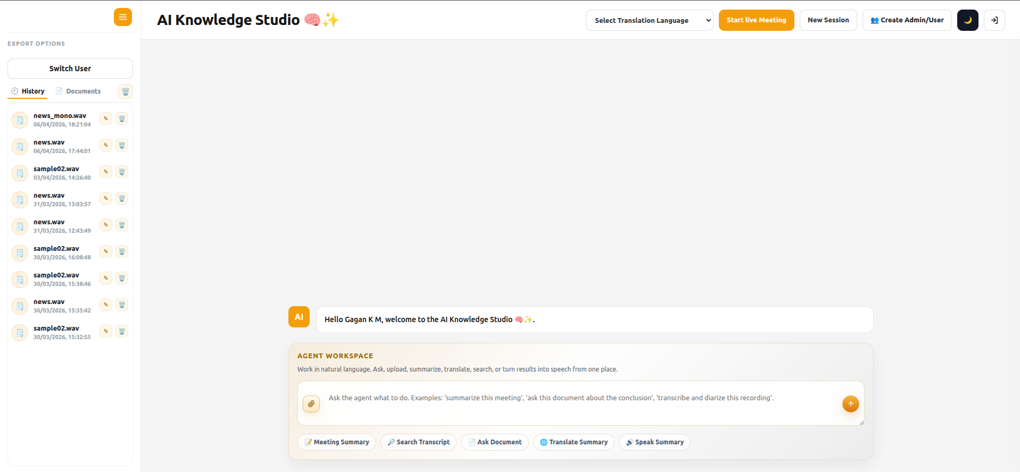
Screenshot of Ai Knowledge Studio
12/28

Slide 13
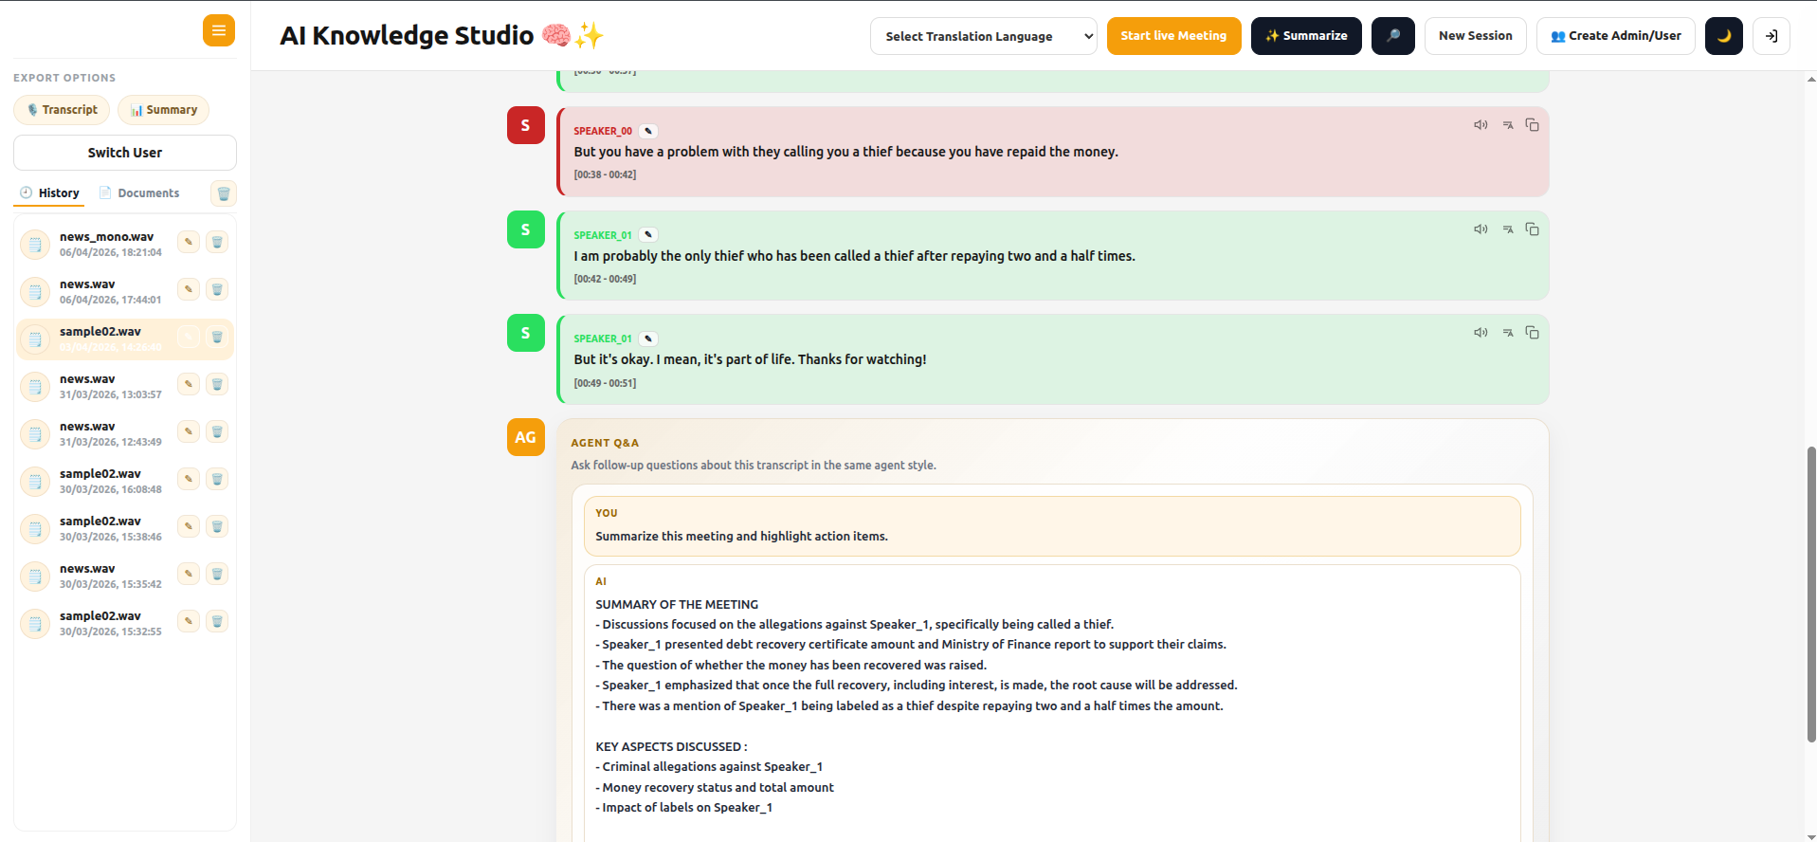
Screenshot of Ai Knowledge Studio
13/28

Slide 14
Face Flow
14/28
Building an AI-powered face detection and recognition system that processes live camera feeds to identify individuals in real time using CNN-based deep learning models.
FEATURES TO LOOK ON:
USe Case : Real-time face detection through live camera feed.
Model Training : CNN-based face recognition for identifying known individuals.
Capability: Support for multiple face detection and recognition at the same time.
Special Feature :Unknown person detection when a face is not present in the trained dataset.
Users CRUD :Face image dataset training and model retraining support for adding new users.
Application :Attendance, security, and monitoring system integration capability.

Slide 15
System Architecture & Workflow
15/28
End-to-end document processing and retrieval pipeline
# 1
# 2
# 3
Model Training Dataset
CNN ARCHITECTURAL TRAINING
FACE Detection
Employee Image upload via secure web interface or Folder
Training the model to extract key identification statistics and Train using identification learning algorithm
Real time Face detection when Employee enter office environment Automatically
# 4
# 5
# 6
Record Update via CSV and Database
Logout and Login Management
RBAC Based Authentication
updates the Database of employee Logout and Login History checks. Also can be downloaded via Report / PDF CSV for Authenicated persons
Managing the Login and Logout Records uing Real time camera
RBAC based authentication Access and also JWT enabled MFA
QUERY FLOW
RBAC
Auth Check
CAMERA
TURN ON
FACE DETECTED VIA REAL TIME CAMERA
RECORD Storing in Dababase
Records and Database Acces to Administrator and Authenticated profiles

Slide 16
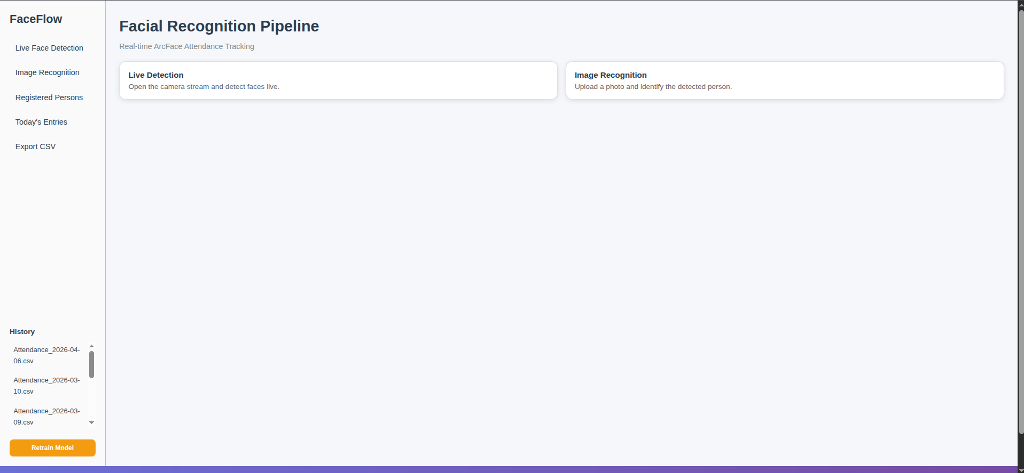
Screenshot of FaceFlow
16/28

Slide 17
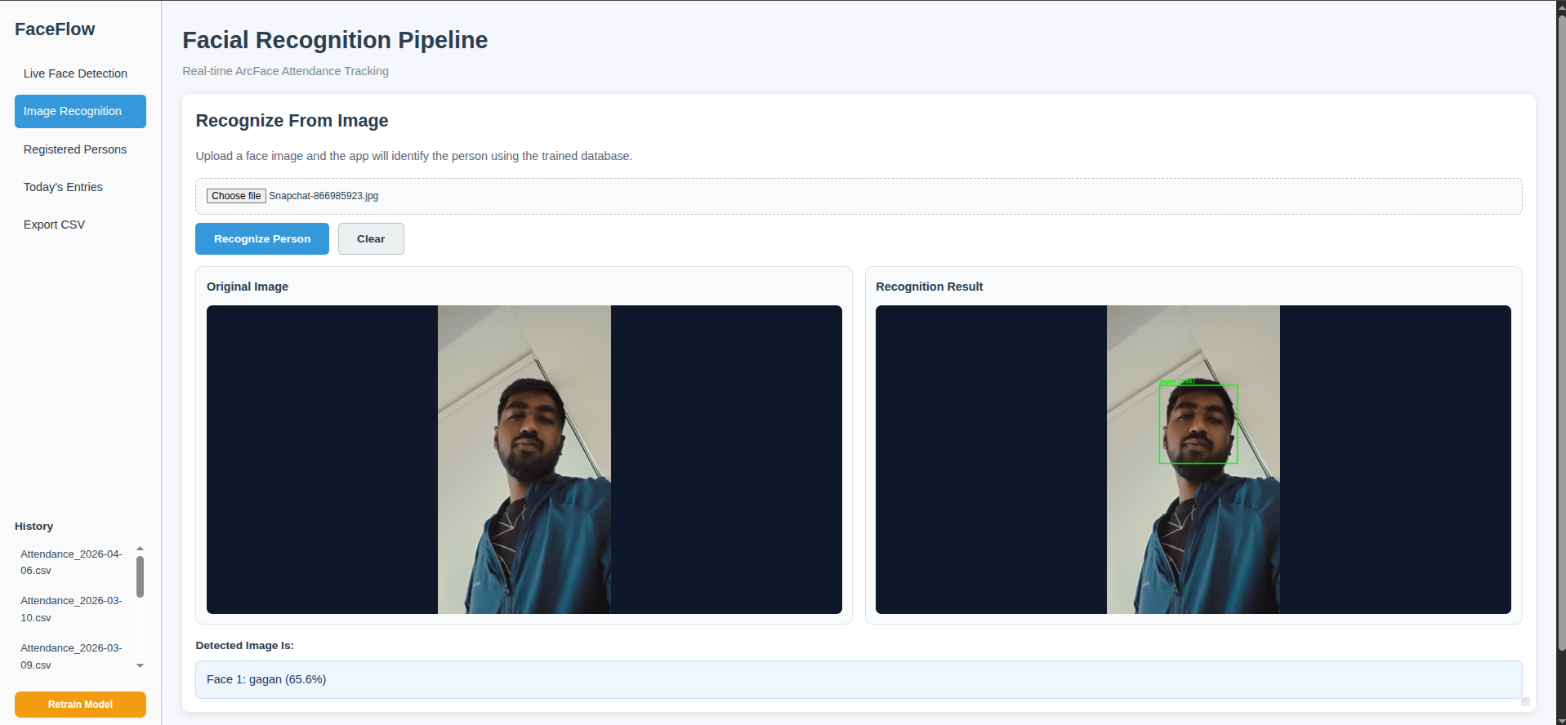
Screenshot of FaceFlow
17/28

Slide 18
CHANGE DETECTION
18/28
AI-Powered Geospatial Change Detection
Transforming before/after satellite imagery into reliable, overlap-aware change intelligence with robust alignment and low false positives.
# 1
# 2
# 3
Overlap-Aware Alignment
Trusted Overlap Extraction
House/Structure-Guided Matching
Automatically aligns misaligned before/after images (shift, partial overlap, slight rotation) before any change analysis.
Finds valid common region and ignores non-overlapping coverage to prevent false detections.
Prioritizes building-rich regions for more stable registration in real-world aerial/satellite scenes.
# 4
# 5
# 6
Local Patch Refinement
Robust Change Detection
False Positive Control & Outputs
Refines alignment patch-by-patch (ECC/translation) to correct residual local drift and parallax effects.
Hybrid detection (intensity + structure + color) with adaptive thresholds to capture true new/removed structures.
Applies morphology + component filtering + confidence rules; outputs change map, boxed results, overlay, and JSON report.

Slide 19
System Architecture & Workflow
19/28
#1
#2
#3
#4
INPUT LAYER
CONFIG LAYER
ALIGNMENT LAYER
Core Processing
Before + After image pair
Differing sizes/resolutions OK
Runtime args & thresholds
Alignment & fallback policies
Precision vs. recall tuning
Geospatial reprojection or feature-based reg.
Valid overlap region extraction
Comparison-ready image pair
Tiled inference on overlap region
DL backends: native + optimized
Unified probability surface
#8
#7
#6
Reconstruction
#5
Output Layer
Model Layer
Core Processing
Overlap → full-scene reprojection
Before-image reference frame
Positional consistency preserved
Binary & probability change maps
Visual overlays + bounding boxes
Alignment metadata & diagnostics
Pluggable model abstraction
Pretrained checkpoint loading
Swap architectures at runtime
Confidence & consistency filters
Edge/intensity gates + smoothing
Connected-component cleanup

Slide 20
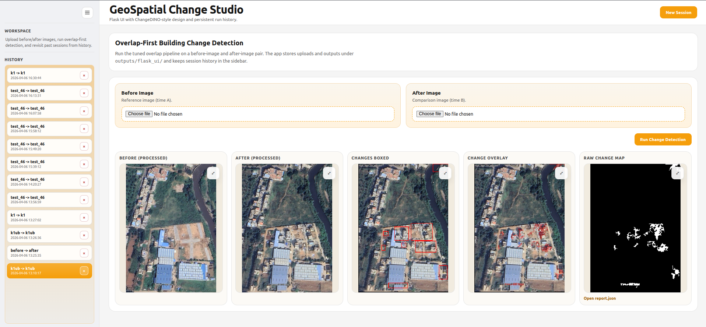
Screenshot of Geo-Spatial change Studio
20/28

Slide 21
Video Analytics and Intelligent OCR
21/28
Vision Language Models extract structured data from drone/CCTV video frames — burned-in telemetry, GPS coordinates, license plates, timestamps, and identifiers
# 1
# 2
# 3
Video/Image Input
Frame Sampling
VLM Inference
Drone video feeds or CCTV footage ingested; burned-in telemetry/OSD visible in frames
Intelligent keyframe extraction reduces redundancy while
preserving all unique text content
Vision Language Model processes each frame for text detection
# 4
# 5
# 6
Text Region Detection
Structured Data Output
Downstream Analytics
OCR + object detection localizes text regions; lat/lon, timestamps, ID’s extracted
Parsed GPS coordinates, timestamps, vehicle IDs compiled into structured
JSON/CSV
Extracted data feeds GIS mapping,
forensic analysis,
license plate cross-referencing

Slide 22

VLM-Powered Agentic OCR & CCTV Analysis Pipeline
22/28
Component | Module | Model / Technology
VLM Core | Vision Language Model | Llama 3.2-Vision 11B (Local via Ollama)
Inference | VLM Deployment | Ollama (GPU-first subprocess, auto-started)
Detection | Plate ROI Crop | YOLOv8n (bounding box crop)
Vision | Frame Preprocessing | OpenCV CLAHE + blackout detection
Validation | Plate Text Validation | Regex + Confidence Filter (Pydantic pipeline)
Anomaly | CCTV Anomaly Detection | Laplacian Blur Scoring + VLM scene analysis
Timeline | Gap Detection | Custom Python Agent (timestamp tracker)
Pipeline | Orchestration | LangGraph + FastAPI (async pipeline)
Storage | Storage & API | SQLite + FastAPI REST layer

Slide 23
Object Detection
23/28
Human & Weapon Detection
Real-time YOLO-based detection of humans and weapons in surveillance feeds — trained on specialized weapons dataset with confidence-scored threat flagging
# 1
# 2
# 3
Input Source
Frame Preprocessing
YOLO Inference
Live CCTV/camera feed or uploaded video/image; multi-source streaming
can be supported
Process the video into frames and frame correction and aligning
YOLOv8/v9 backbone performs
single-pass detection for humans and weapon classes
# 4
# 5
# 6
NMS & Filtering
Threat Classification
Alert & Logging
Non-Maximum Suppression filters overlapping detections;
confidence thresholding
Detected objects classified — human / weapon type (firearm, knife, etc.) with bounding boxes
High-confidence weapon detections
trigger alerts; frames logged with
metadata for review

Slide 24
Resource
24/28
CENTRALIZED PLATFORM TOOLS FOR SMARTER DETECTION FRAMEWORKS
CAPABILITIES | Tools / Models Used | PURPOSE
Object Detection | YOLO | YOLO models for object detection. YOLOv8, YOLOv11 (Medium scale models).
Weapon Detection | Training Dataset | Dataset from Kaggle with about 1000+ images of Weapons. Trained for 200 epochs with an accuracy of 76%.
Input format | Upload files from UI | Videos and Images both supported.

Slide 25
Overall - Models used,
Benchmarks and Training
25/28
Models Used
Model Name | Specification | PURPOSE
Llama 3 | 3.1:8b | For LLM Respone generation in Document intelligence chatbot
NLLB (No language left behind-Meta) | Translation model | For conversion of any language to english and vice versa with support upto 250+ languages.
Llama vision | Vision model | For Video analytics and OCR extraction from images/videos.
Yolo-models | YOLOv8,v11 | For object detection - Weapons, Humans, objects.
MINI-L6 v2 | embedding model | Used to embed text into the vector database and to reterive the vectors as well for Document Intelligence chatbot and AI Knowledge Studio.
Multilingual Translation | NLLB-200 | Translates text into multiple languages with contextual accuracy
Llama Mistral | 3.1:8b | For LLM Respone generation in Ai knowledge Studio
Nvidia NeMo ASR | Diarization & Mapping Model | Used for Automatic speech Recognition and Diarization
Faster Whisper | Open-Ai whisper | used to transcribe the audio to Extract the Data through texts
Demucs model | Denoising Model | It is used to Denoise the audio to remove the Background Noise and extract the pure Vocal Audio.

Slide 26
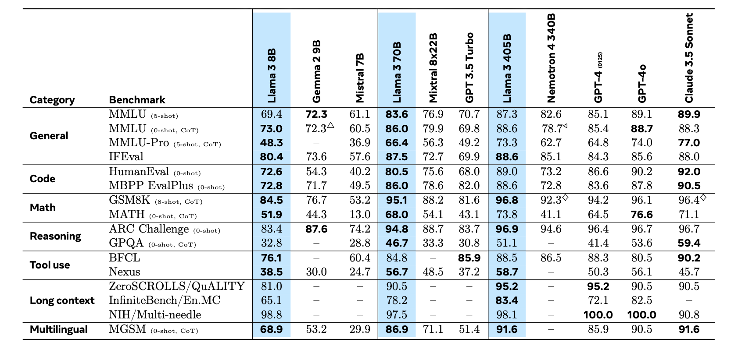
Model’s
Benchmarks and Training
26/28
NOTE: We have used the pre-trained weights of the llama 3:8B parameters models, with fine tuning if required

Slide 27
Overall - Models Training
27/28
Stage | What Happens | Key Techniques
Data Collection | Gather large-scale data (till 2023) | Multi-source datasets
Data Cleaning | Remove unsafe & low-quality data | PII filtering, deduplication
Data Curation | Extract useful text from web | HTML parsing, boilerplate removal
Quality Filtering | Select high-quality content | Heuristics + ML classifiers
Specialized Pipelines | Extract domain-specific data | Code & reasoning classifiers
Multilingual Processing | Handle multiple languages | Language detection (176 langs)
Data Mix Optimization | Balance dataset composition | Scaling laws, classification
Final Data Mix | Structured token distribution | 50% general, 25% reasoning, 17% code, 8% multilingual
Annealing Phase | Final training refinement | Upsampling high-quality math/code
NOTE: All Data is taken from the offical Release of the paper by META: “Llama 3 Herd of models” → Paper-link

Slide 28
Models Training Time
28/28
Model Type | Task | Dataset | Training Time | Training Approach | Notes
YOLO (Object Detection) | Weapon Detection | Weapons Dataset from Kaggle (~5000+ images) | ~6–7 hours | Supervised training (YOLO architecture) | Real-time detection capability
Transformer Model | Change Detection (Images) | LEVIR-CD+ Dataset | ~5–6 hours | Transformer-based vision model | Detects pixel-level spatial changes
LLM (Fine-tuning) | Task-specific adaptation | Depends on use-case dataset | Varies (depends on dataset size) | PEFT (LoRA / QLoRA) | Efficient fine-tuning with low compute

